Slide 1
STATISTICAL ANALYSIS
CREATED & PRESENTED BY: DATA LEGION

Slide 2

SPOTIFY
Spotify is a proprietary Swedish audio streaming and media services provider founded on 23 April 2006 by Daniel Ek and Martin Lorentzon. It is one of the largest music streaming service providers, with over 456 million monthly active users, including 195 million paying subscribers, as of September 2022.

Slide 3
Dataset information and What we are trying to achieve?
Spotify dataset is taken from Kaggle containing songs from 1920 to 2020.
In this dataset, We are trying to achieve,
Data analysis to find out top 10 songs, top 10 artists and how the audio characteristics changed over the years.
How the audio characters are distributed.
If any attributes are correlated.

Slide 4
PROCESS
UNDERSTANDING THE DATA
ANALYSIS
STEP 02
STEP 04
STEP 01
STEP 03
DATA CLEANING
VISUALIZATION

Slide 5
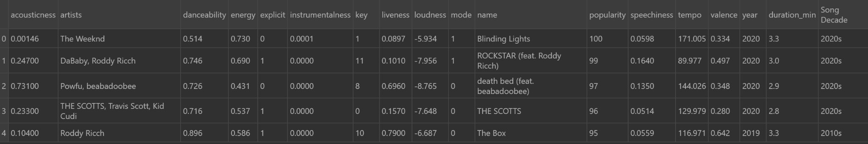
UNDERSTANDING THE DATA
#Reading CSV into variable dataset
df = pd.read_csv('F:\StatsProj\Spotifynewclean.csv')
df.head()

Slide 6
KEY ATTRIBUTES
Name
Year
Duration
Popularity
Artists
Key
Mode
Energy
Tempo
Decade
Explicit
Valence
Loudness
Liveness
Danceability
Speechiness
Acousticness
Instrumentalness

Slide 7
UNDERSTANDING THE ANALYSIS
Importing Libraries
Data Cleaning
Numpy
Pandas
Matplotlib and
Seaborn
Checking Null Values
Removing Duplicates
Fetching Data Info

Slide 8
DATA CLEANING AND MODIFICATION
1. Removed inconsistent values, garbled characters, and duplicates.
2. Data Modification on the column ‘year’: Since this dataset contains songs from 1920 to 2020, in order to have a whole picture based on decades, we have added a new column called ‘Song Decade’
3. Data Modification on Duration: Earlier, the duration of songs were provided in milliseconds and changed it to minutes by dividing them by ‘60000’.

Slide 9
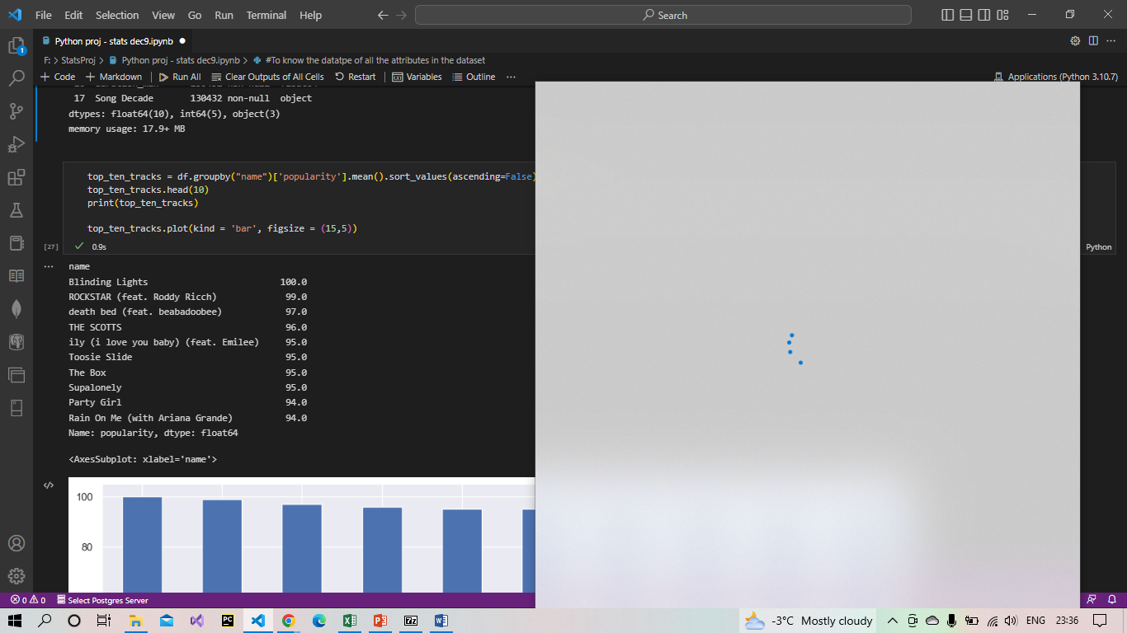
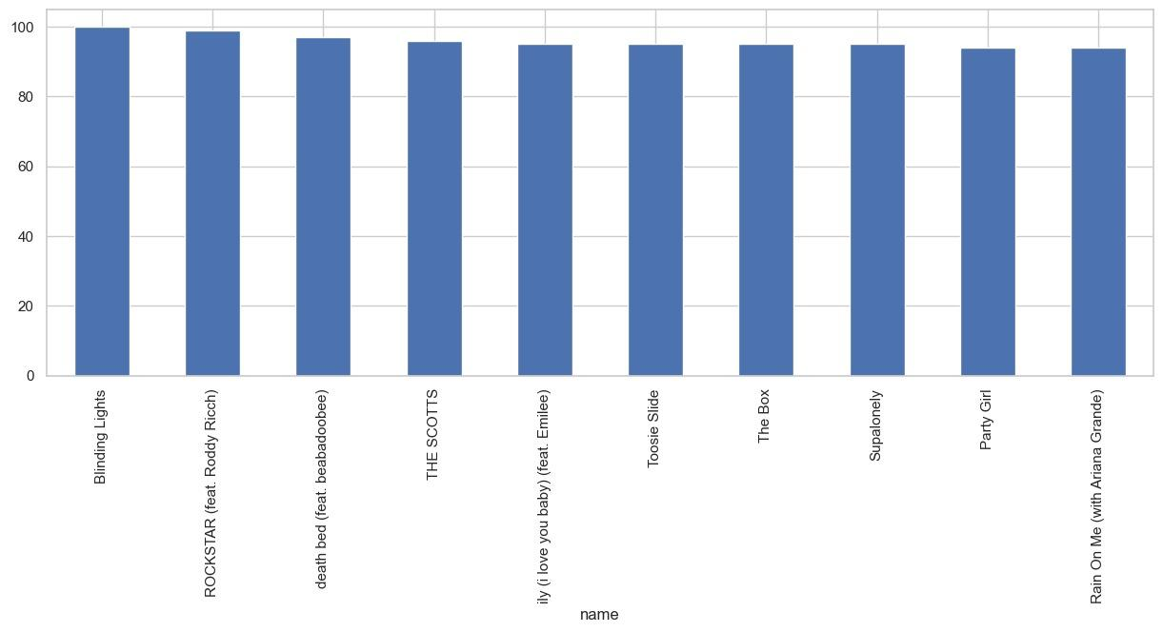
ANALYSIS
#TOP 10 TRACKS
Top_ten_tracks=df.groupby("name")['popularity'].mean().sort_values(ascending=False).head(10)
top_ten_tracks.head(10)
top_ten_tracks.plot(kind = 'bar', figsize = (15,5))

Slide 10
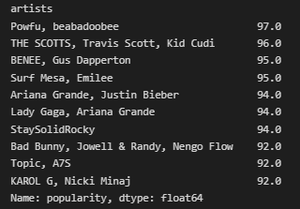
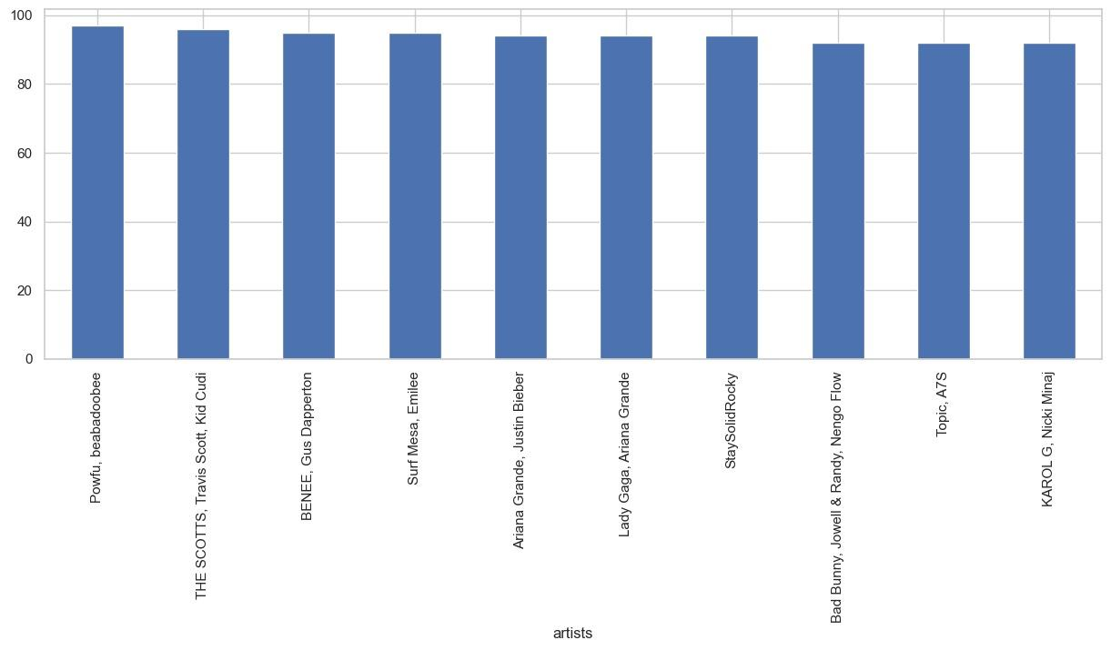
#TOP 10 ARTISTS
top_ten_artists = df.groupby("artists")['popularity'].mean().sort_values(ascending=False).head(10)
top_ten_artists.head(10)
top_ten_artists.plot (kind = 'bar', figsize = (15,5))

Slide 11
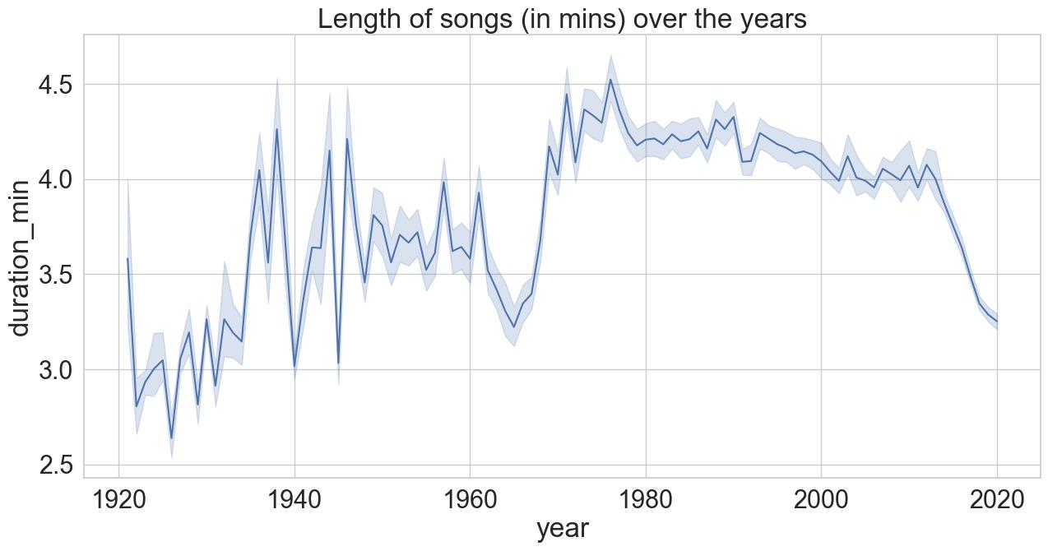
#LENGTH OF SONGS OVER THE YEARS
sns.set_style(style="whitegrid")
fig_dims=(15,7)
fig,ax=plt.subplots(figsize=fig_dims)
fig=sns.lineplot(x=df["year"],y=df["duration_min"],ax=ax).set(title="Length of songs (in mins) over the years")

Slide 12
VISUALIZATIONS

Slide 13
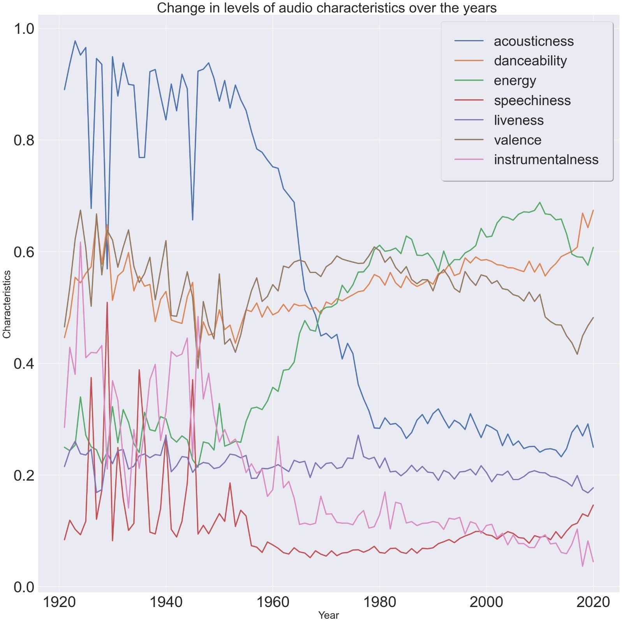
AUDIO CHARACTERISTICS OVER THE YEARS

Slide 14
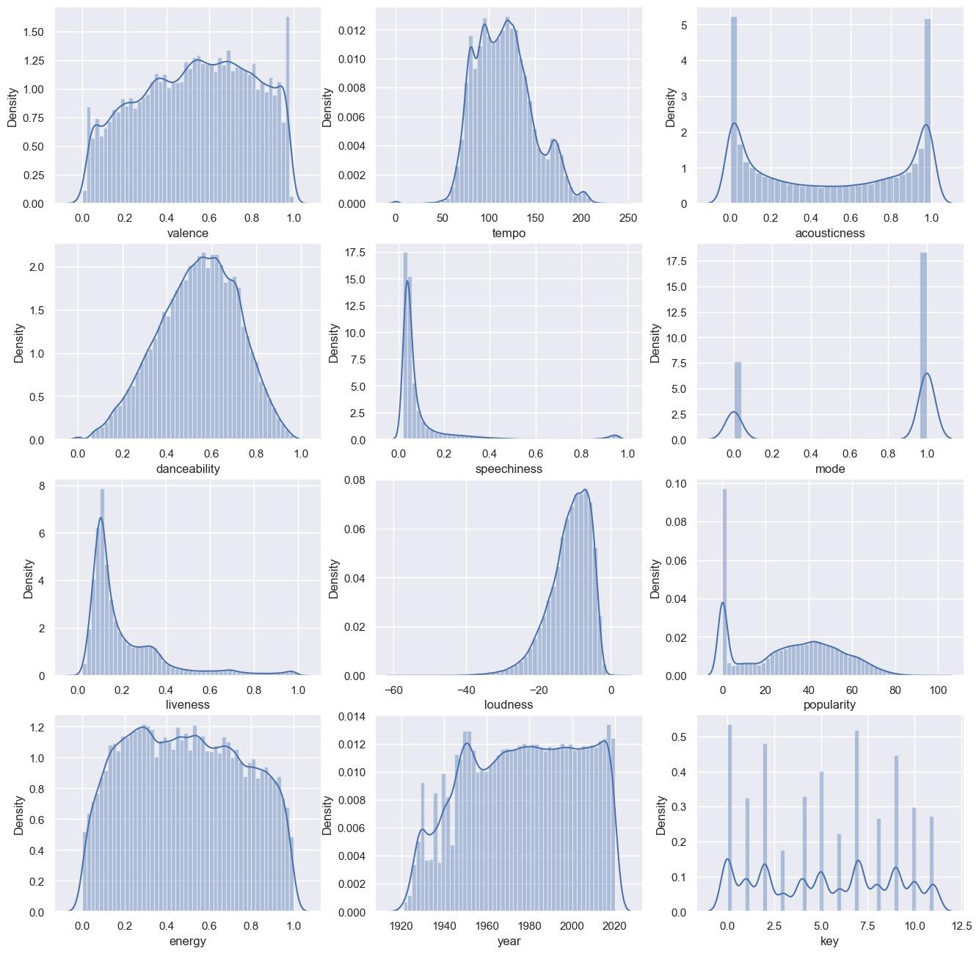
DISTRIBUTION OF AUDIO CHARACTERISTICS

Slide 15
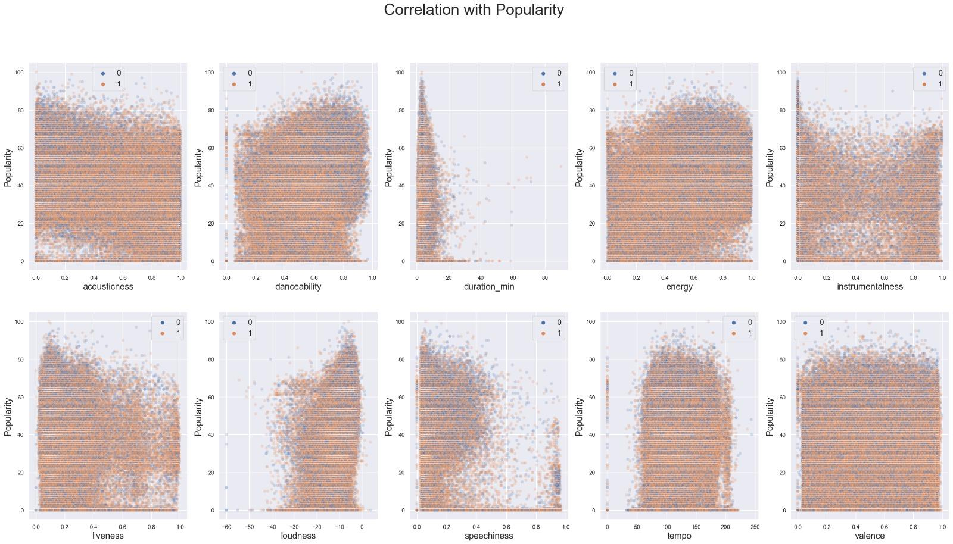
CORRELATION: POPULARITY & ATTRIBUTES

Slide 16
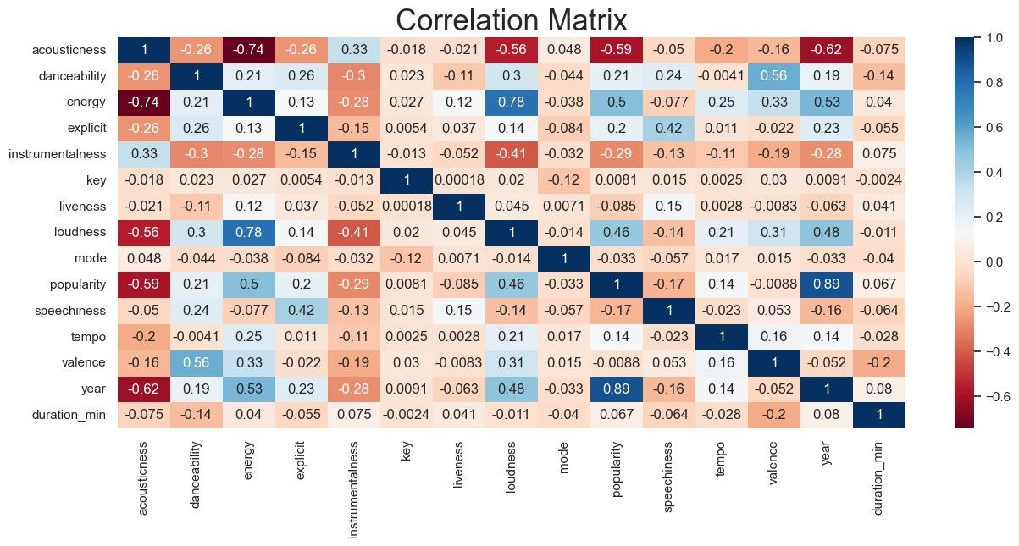
CORRELATION MATRIX

Slide 17
CONCLUSION
The Analysis was aimed at representing the evolution of music over the century(from 1920-2020). It also depicts how different audio characteristics changed over the years. For example, the in the recent years the energy and loudness in the songs have gone up and the acouticness is gone down with the emergence of hip hop and EDM music.

Slide 18




OUR GROUP: DATA LEGION
KRITHICK BALAKRISHNAN
MOHAMMAD ABDUL AQUIB KHAN
MOHAMMED FAISAL SHARIEF
MOHAMMAD ANSAR KADER MEERA SAHIB
THANK YOU!

